Slide 1
My Number
Interactive Notebook
Name
Class
Teacher
Term 1 Semester 1
1

Slide 2
Create your own front page
It needs to contain the following –
My number interactive notebook
Name
Class
Teachers Name
Semester 1 Term 1
Page number 1

Slide 3
Contents
Glossary or Formula Page
Page
Date
Description
2
3

Slide 4
Tasks
24
7
30
Essential Question
Questions
Notes
Summary
4
5

Slide 5
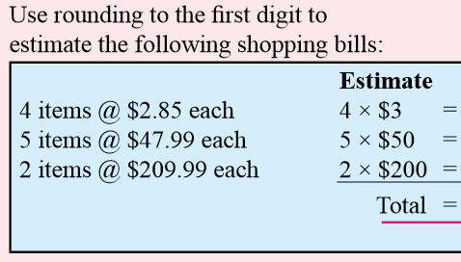
24
7
30
Date
Money
EQ – Estimating
An estimate of how much we have to pay is useful
Leading digit estimation
Rounding to the first digit gives a fairly rough estimate, but is close enough for many purposes.
5

Slide 6


24
7
30
Date
Money
EQ – Estimating
I DO
WE DO
5

Slide 7
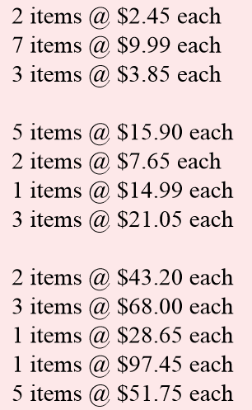
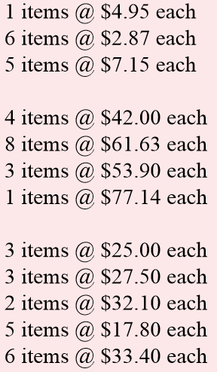
Questions

Slide 8
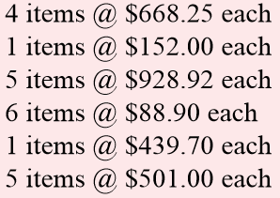
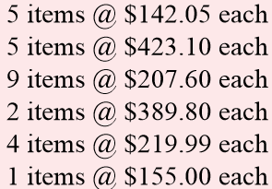
Questions

Slide 9
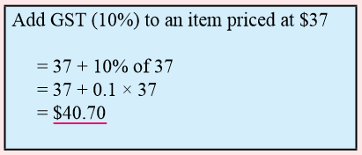
24
7
30
Date
Money
EQ – GST
The GST is a tax of 10% on most supplies of goods and services in Australia from 1 July 2000.
Step 1 – Add 10% of the original amount
5

Slide 10
24
7
30
Date
Money
EQ – GST
Add GST (10%) to the price of each of the following items:
I DO
A sandwich @ $2.15
Cable subscription @ $43
WE DO
A watch @ $415.85
A filing cabinet @ $220
5

Slide 11
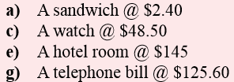
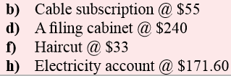
Questions

Slide 12
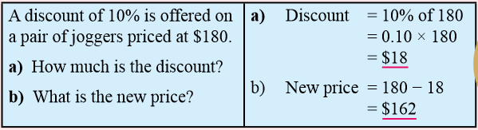
24
7
30
Date
Money
EQ – Discounts
Items are often discounted when shops try and increase
customers
Step 1 – Multiply the original amount by the discounted
percentage (10% 20% etc.) and subtract this from the
original amount.
5

Slide 13
24
7
30
Date
Money
EQ – Discounts
A discount of 10% is offered on each of the following items. Find the discount, and the new price:
I DO
A single bed @ $210
A vase @ $20
A discount of 20% is offered on each of the following items. Find the discount, and the new price:
WE DO
An Angus bull @ $3600
A 20-year old ute @ $2000
5

Slide 14

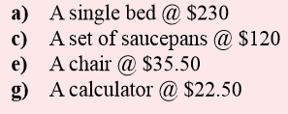
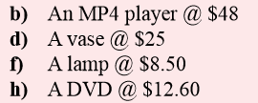
Questions

Slide 15
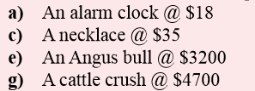
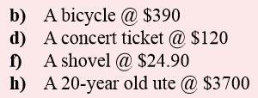
Questions

Slide 16
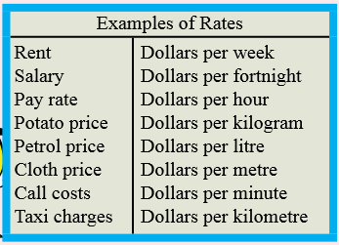
24
7
30
Date
Money
EQ – Rates
A rate is a comparison of quantities of different kinds
5

Slide 17
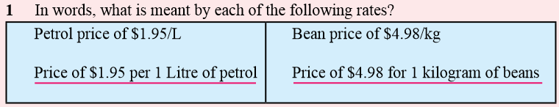
24
7
30
Date
Money
EQ – Rates
Rates are in the form of $ per unit measurement ie. Bananas are about $4/kg
5

Slide 18
24
7
30
Date
Money
EQ – Rates
I DO
Petrol price of $1.05/L Wool price of 850c/kg
WE DO
Land price of $18 000/ha Call cost of 77c/min
5

Slide 19
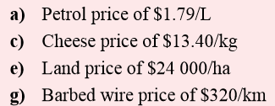
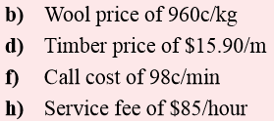
Questions

Slide 20
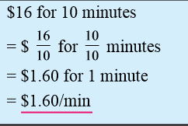
24
7
30
Date
Money
EQ – Rates
How to simplify rates
Step 1 - Divide the $ price by the unit quantity
5

Slide 21
24
7
30
Date
Money
EQ – Rates
Simplify each of the following rates:
I DO
$24 for 6 hours $30 per 2 kg
WE DO
$42 for 13 buttons $55 per 11 seconds
5

Slide 22
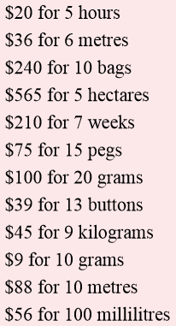
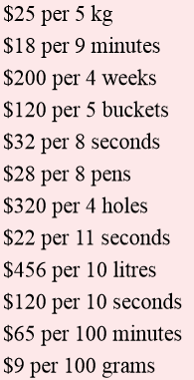
Questions

Slide 23
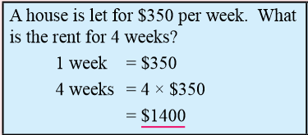
24
7
30
Date
Money
EQ – Rates
We can use rates to calculate the amount of money required
Step 1 – Multiply the rate by the unit quantity
5

Slide 24
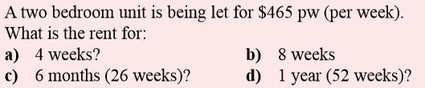
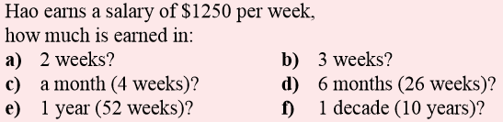
24
7
30
Date
Money
EQ –
I DO
WE DO
5

Slide 25
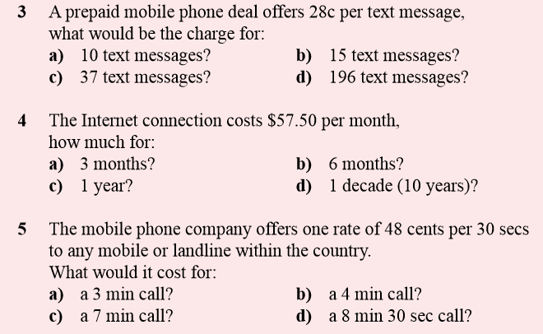
Questions

Slide 26
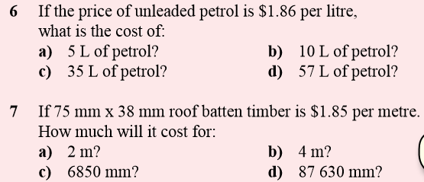

Questions

Slide 27
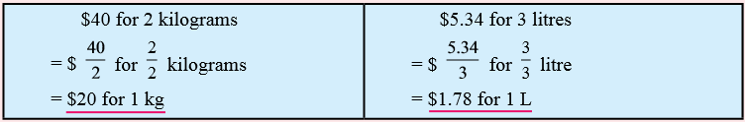
24
7
30
Date
Money
EQ – Unitary Method
The unitary method is a useful method for comparing one rate with another rate.
Step 1 – Find the unit rates for a single quantity and
Find the rate for one in each of the following:
5

Slide 28
24
7
30
Date
Money
EQ – Unitary Method
Find the rate for one in each of the following:
I DO
$12 for 2 kg $24 for 4 litres
WE DO
$4.50 for 25 g $5.60 for 60 grams
5

Slide 29

Questions
Find the rate for one in each of the following:
Which is the best buy?

Slide 30
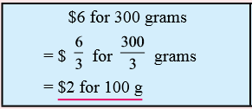
24
7
30
Date
Money
EQ – Unitary Method
The unitary method can also find the rate for 100 (if the second quantity is larger than 100).
Step 1 – Reduce the quantity down to 100
Step 2 – Divide this number in to the $ amount
5

Slide 31
24
7
30
Date
Money
EQ – Unitary Method
Find the rate for 100 of each of the following:
I DO
$50 for 200 g $12 for 840 mL
WE DO
$27 for 900 g $11.4 for 200 g
5

Slide 32

Questions
Find the rate for 100 of each of the following:
Which is the best buy?

Slide 33
24
7
30
Date
Money
EQ –
5

Slide 34
Questions

Slide 35
Notes Review
24, 7 ,30
Date
Title
Essential question
Notes complete
Notes complete with colour and diagrams
Questions completed
Contents page filed in
Formula page filled in

Slide 36
Homework
Review your notes and write a summary answering the essential question.

